Slide 1
Electric vehicle technologies
21st APEC workshop on energy statistics: data collection on new energy products and technologies, Tokyo
Energy Statistics and Training Office (ESTO), Asia Pacific Energy Research Centre
Finbar Maunsell
14 September 2023

Slide 2
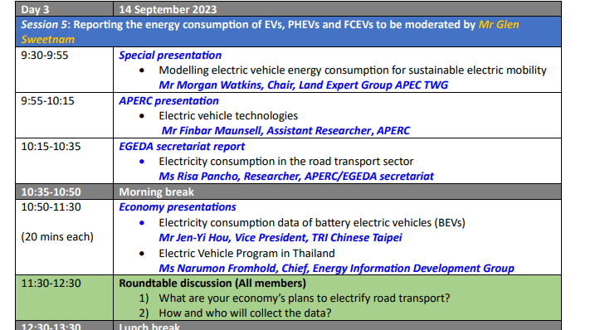

Slide 3
Electric Vehicle Technologies
Outline:
Estimating EV energy use
Separating EV energy use from buildings energy use
Projecting energy use
Charging statistics
Hybrids
FCEVs

Slide 4
The most important value
Stocks (registered vehicles) - if you know this, you can estimate any other value.
Breaking stocks into vehicle types (e.g. car/truck/van/bus) is the next most useful thing.
This applies to all engine types, not just EVs.

Slide 5
Estimating EV energy use
Mileage: the amount of km that the average vehicle drives per year
Efficiency: energy use per km travelled (km/energy)
(These factors can be found online, or I am happy to provide what I use for your economies.)
Mileage*Stocks = km travelled per year
Km/Efficiency = Energy
Notes:
A lot of agencies don’t have to estimate petrol or diesel energy use because it comes from suppliers or other agencies. But now, as things are changing quickly, this isn’t possible.
This is how you can estimate transport energy use for both EVs and other engine types.
Mileage:
6,000 on a 2w
12,000 on a lpv,
60,000 in a lcv
100,000 in a ht

Slide 6
Separating EV energy use from buildings energy use
Charging in homes and at charging depots can easily be accidentally recorded in residential or services categories.
Unless you know/estimate public charger use, it is difficult to understand how much EV use to take away from these categories.
An EV could use around 200-150kwh monthly. That is about 30% of an average US households current energy use, or 40% of an Aussie household.
This is why the time of charging is so important. Shift it later into the night, or during the day, and you spread the peak out a lot.

Slide 7
Projecting energy use
If you base your projections off stocks, you will want:
Sales shares (the proportion of new vehicles sold that are EV’s)
Most economies already have targets for these so they can provide a reference point
Turnover rates
3% works, but it can differ based on the average age of vehicle stocks.
Additional stocks per year:
After stocks to replace the turnover of stocks, there are the new vehicles to satisfy new demand. Historic trends in the change in total vehicles stocks per year can tell you how many additional sales there are per year.
Our model calculates this using passenger/freight km and its growth.
So:
New EV’s = (Additional stocks per year + turnover) * sales share of EV’s.

Slide 8
Charging statistics
Charger to stock ratios
Studies show economies seem to require around 1 charging point per 10 EVs. This can change based off:
the number of fast/slow chargers (faster charging means less chargers needed).
private charging availability
average battery capacity
Driving patterns
Finer detail: Kw charger to kwh of battery ratios
Even better.

Slide 9
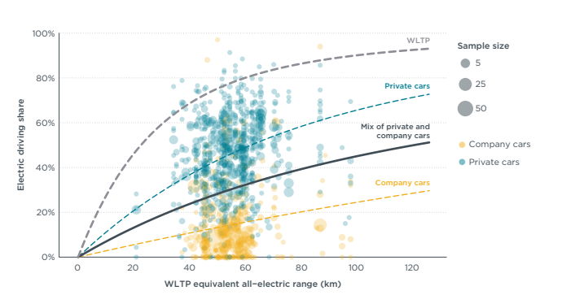
Hybrids
Studies still being done, but its important to know how people use electricity vs fuel in their hybrids.
Current estimates are 50%, or less (link in notes at the end)
Should only track plug in hybrid electricity use. Non-plug-in hybrid electricity use comes from fuel consumption.
Chart from ICCT - Real-world usage of plug-in hybrid vehicles in Europe

Slide 10
FCEV’s
Fuel cell electric vehicles
These convert hydrogen into electricity. Therefore, energy use is recorded as hydrogen energy use.
Energy can be estimated using stocks.

Slide 11
Wrap up and key takeaways
Stocks are the most important metric to track. Once you have that, the rest is easy.
Difficult to separate charging from buildings energy use, unless you know public charging statistics.
Separate hybrids by their type. Non-plug-in hybrids can be treated like they only use fuel.

Slide 12
Appendix
Hybrid electricity usage share - https://theicct.org/wp-content/uploads/2022/06/real-world-phev-use-jun22-1.pdf
Useful pages on how different EV technologies work https://afdc.energy.gov/vehicles/how-do-hybrid-electric-cars-work
IEA trends in charging infrastructure - https://www.iea.org/reports/global-ev-outlook-2022/trends-in-charging-infrastructure
ICCT report on charging (very informative) - https://theicct.org/wp-content/uploads/2021/06/EV_charging_guide_03162020.pdf
Detailed breakdown of EV lifecycle emissions https://www.iea.org/data-and-statistics/charts/comparative-life-cycle-greenhouse-gas-emissions-of-a-mid-size-bev-and-ice-vehicle
I will supply a workbook containing factors for mileage/efficiency and more. Plus some other data.

